Slide 1

2019
Statistics Clinic
Boys Lacrosse in New York Section V

Slide 2

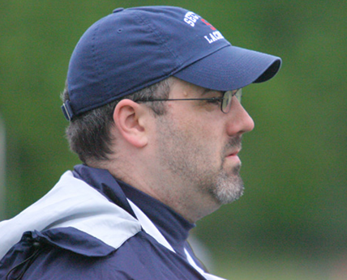
Kyle Barrett
and
Paul Wilson

Slide 3
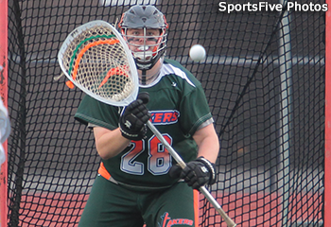

Slide 4
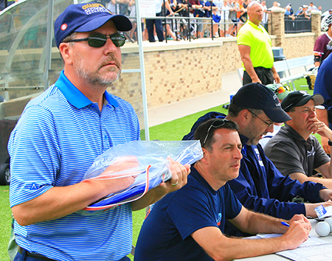
Agenda
Ethics
NCAA Stats Manual
Definitions
Forms / Reporting

Slide 5
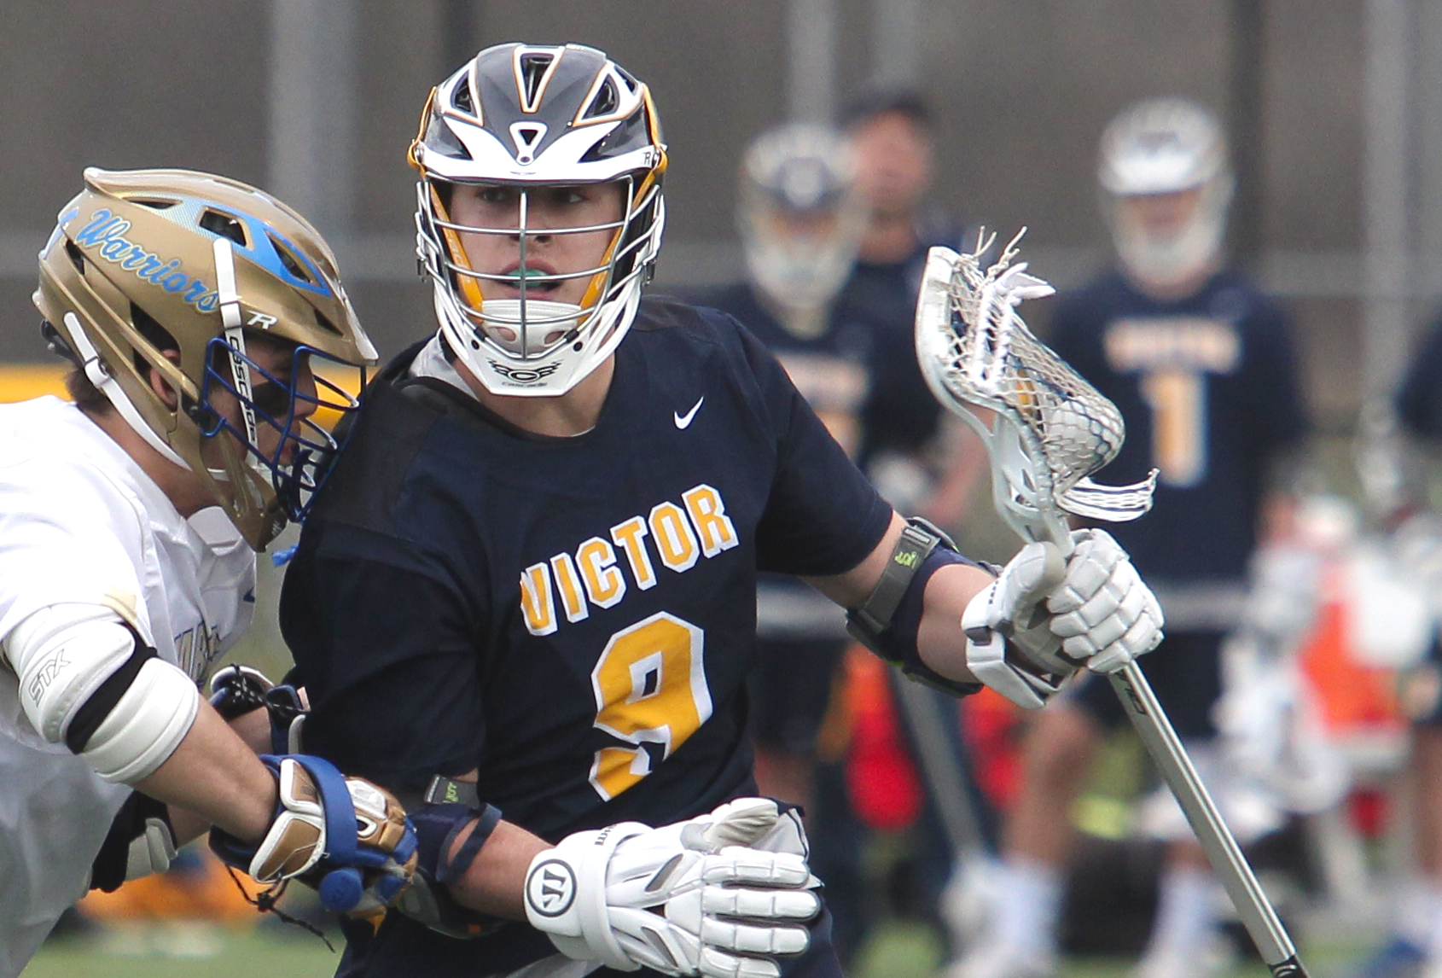

Slide 6
“There are three kinds of lies:
Lies, Damned Lies and Statistics.”
Ethics
Mark Twain
We have an ethical duty
to record the accurate
history of what took place.

Slide 7
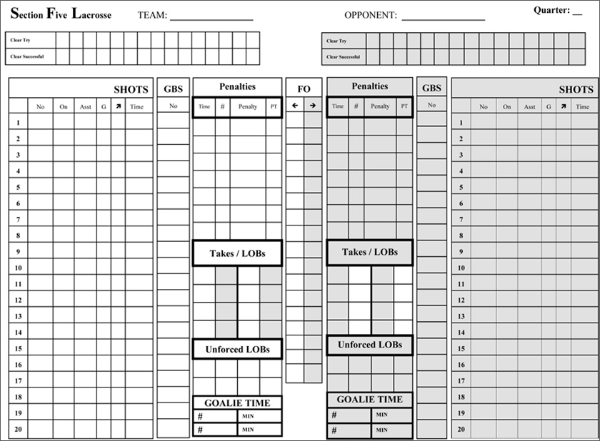
We have an ethical duty to record the
accurate history of what took place
Ethics
1 – Be Professional
2 – Focus on the Play
3 – Ask For Help
4 – No “Padding Stats”

Slide 8
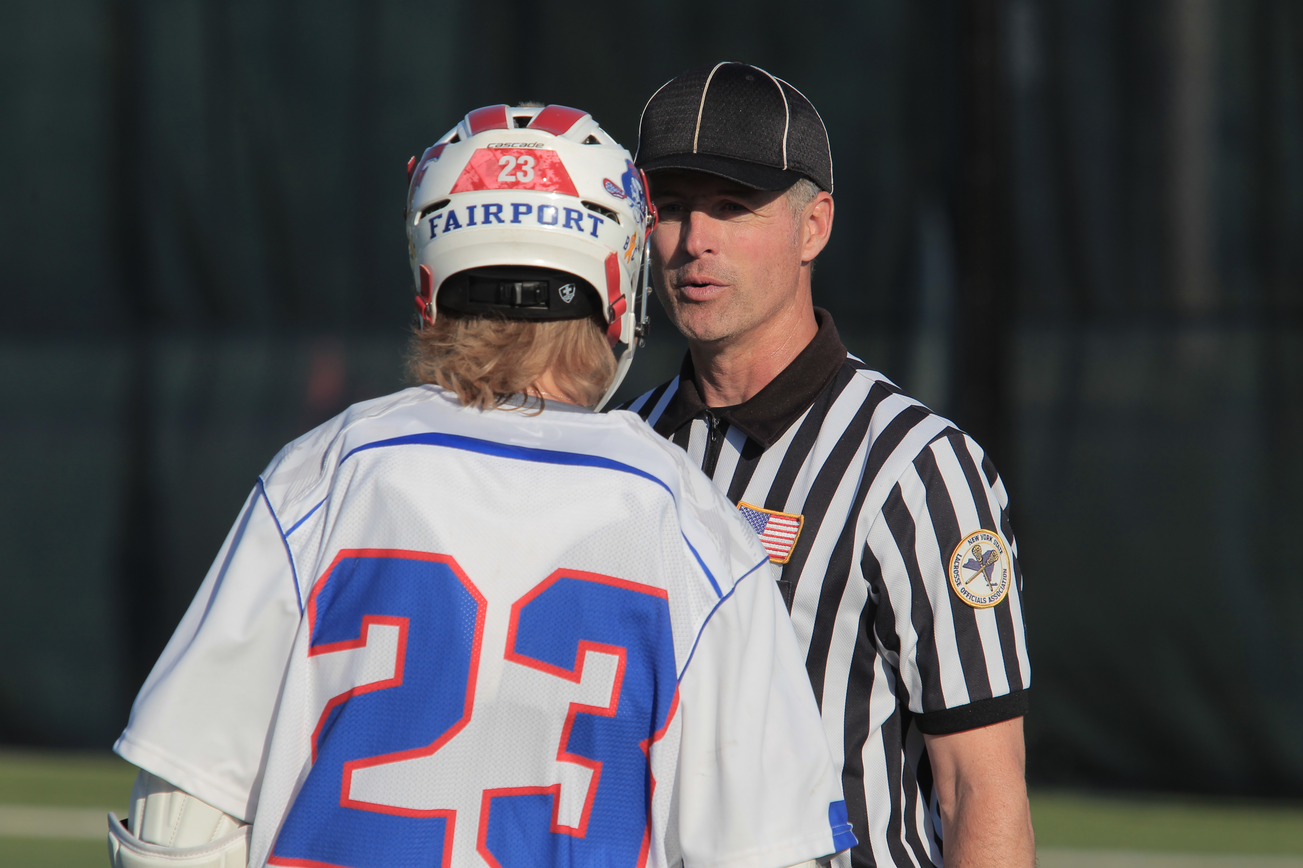

Slide 9
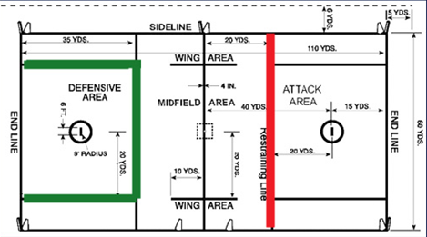
NCAA
CLEARS
Manual
“Philosophy. A clearing attempt is defined as when
A team has possession of the ball behind its
defensive restraining lines to the offensive attack area.”
“A successful clearing attempt involves the team
establishing possession in its offensive end before
the other team gains possession.”

Slide 10
NCAA
CLEARS
Manual
“Article 1. A clear should only be credited when
the clearing team passes the offensive restraining
line with the ball is clearly able to begin an
offensive attempt from such a play…”
“A successful clear occurs the moment the offensive player enters the attack area.”

Slide 11
NCAA
CLEARS
Manual
“Article 2. A team playing man-down should be credited with a successful clear if it meets the conditions of a successful clear, but should not be charged with an unsuccessful clear if it does not.”

Slide 12
NCAA
CLEARS
Manual
“Article 3. All failed clears must have a team or
individual turnover charged.”
“Article 4. Regardless of their position on the field, if a player is attempting a shot, a successful clear should be awarded.”

Slide 13
NCAA
CLEARS
Manual
“A.R.13. If a player shoots from its defensive box and the shot goes wide, credit a successful clear and a shot. If a player shoots from mid-field and the shot is saved by the goalkeeper, credit a successful clear, shot and save.”

Slide 14
NCAA
CLEARS
Manual
“A.R.14. If a player shoots from its defensive box in desperation to beat the clock, do not credit the team with a shot or clear attempt unless the shot was on goal. In that case, credit a shot to the player, a successful clear for the offensive
team and a save for the goalie.”

Slide 15
NCAA
CLEARS
Manual
“A.R.15. If a goalkeeper throws the ball to the other end of the field to beat the clock and the opposing goalkeeper catches it and throws it back to the other end of the field, again, to beat the clock, no statistics are awarded for either team.”

Slide 16
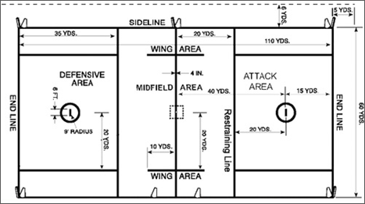
Question
The goalie makes a save and begins to clear the ball. He passes it to a midfielder who crosses the midline.
Is this a successful clear?

Slide 17
Question
Team A starts a clear but the ball is knocked out of their stick. A midfielder on Team A picks the loose ball and runs it into his goal
area. Is this a successful clear?

Slide 18
Question
A defenseman knocks down a pass which deflects outside the front of the goal area. He picks it up and runs to his offensive goal area.
Is this a successful clear?

Slide 19
Question
A defenseman knocks down a pass which deflects outside the right of the goal area. He picks it up and runs into the defensive area. Is this the start of a clear?

Slide 20
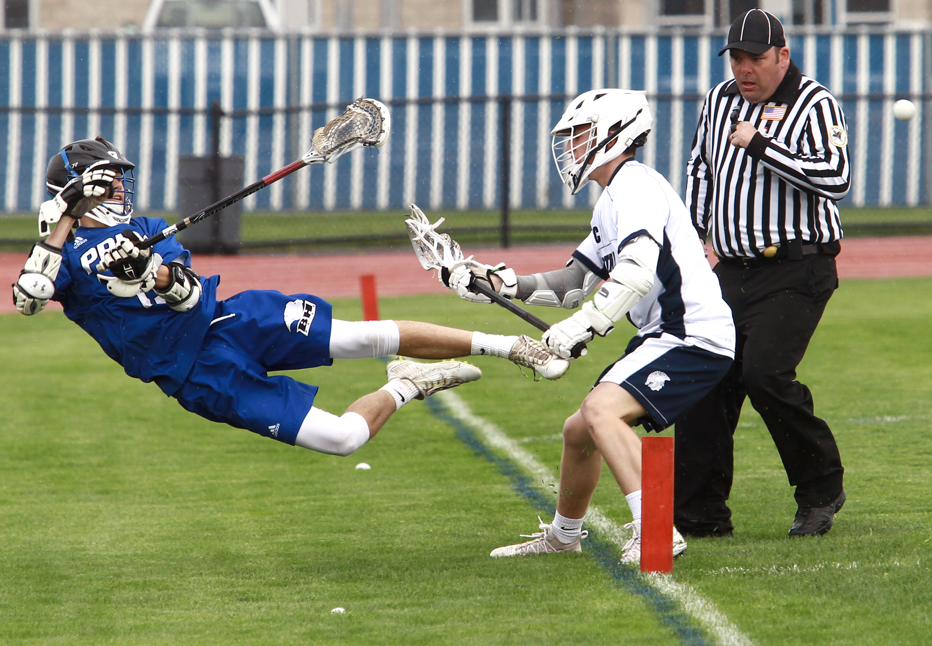

Slide 21
NCAA
SHOTS
Manual
“A ball propelled toward the goal by an offensive player shall be called a shot. The ball may be thrown from a stick, kicked, or otherwise physically directed to be credited as a shot.”

Slide 22
NCAA
SHOTS
Manual
“The statistician should take care to award shots only when possession of the ball can reasonably be said to have occurred or by ricochet or when a controlled effort can be construed somewhat similar to controlled tips in basketball).”

Slide 23
NCAA
SHOTS
Manual
“Article 2. A ball that enters the goal propelled by the offensive team must then become a shot and a goal.
Article 3. A ball that ricochets off another player and enters the goal will be credited as a shot by the player deemed to have scored the goal…”

Slide 24
NCAA
SHOTS
Manual
“Article 4. In the case of a team goal (also known as an own goal), there is no shot recorded.
[See Goals for more definitions.]

Slide 25
NCAA
SHOTS
Manual
“NOTE: One of the most common mis-definition in lacrosse is that of “shot on goal.” A shot on goal is not the same thing as a shot at the goal. The latter encompasses all shots; the former encompasses only shots scoring and those having been saved by the goalie. A shot that hits the pipe is not a shot on goal.”

Slide 26
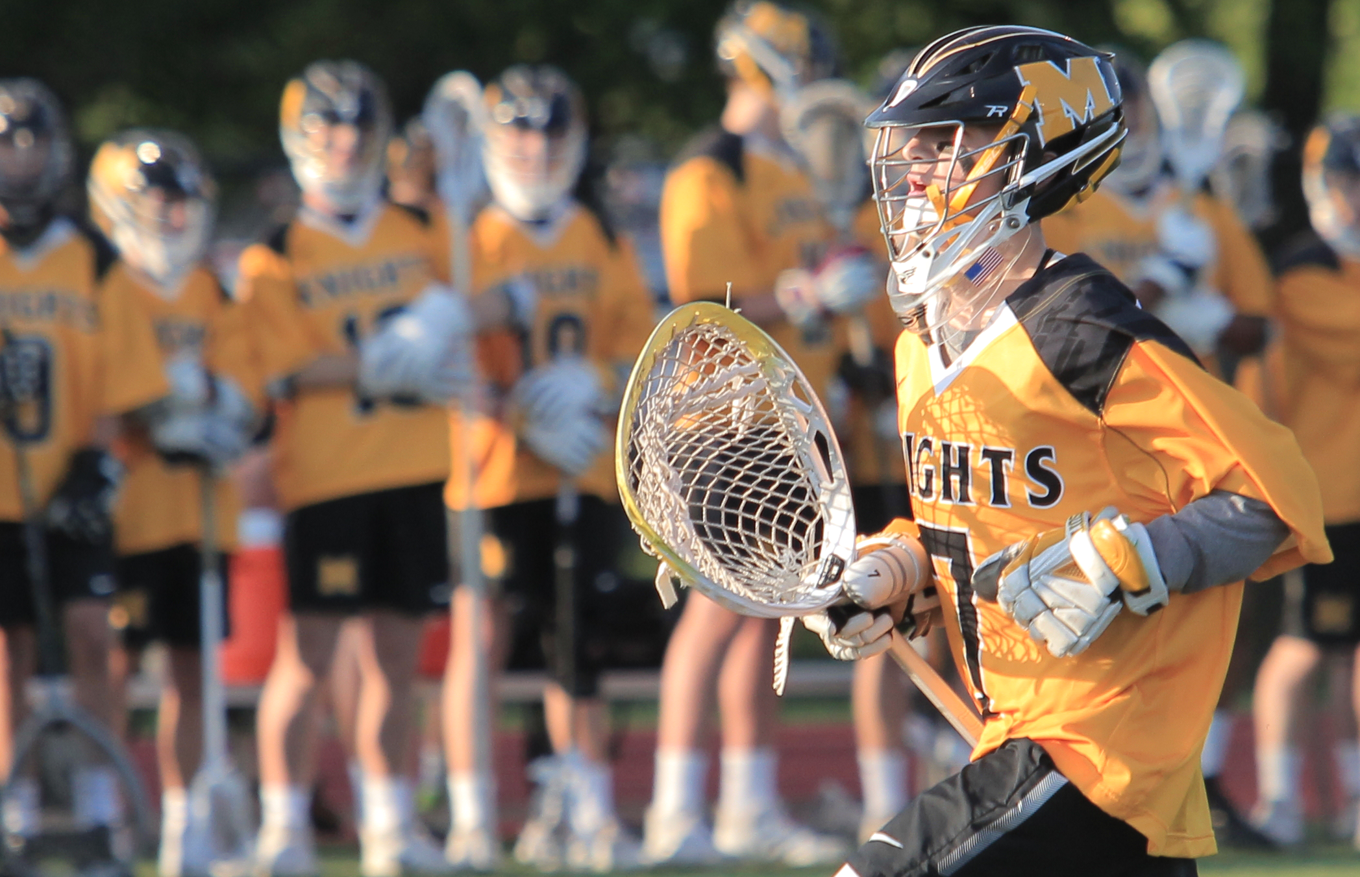

Slide 27
NCAA
GOALS
Manual
“Article 1. A goal should be credited to the player who shot the ball, scoring a goal for his own team. In certain situations, a team goal (also known as “own goal”) may be credited. However, statisticians should err on the side of awarding the goal to the player who took the original shot.”

Slide 28
NCAA
GOALS
Manual
“(1) A shot that strikes another offensive player and deflects into the goal should be credited as a goal to the player who last touched the ball before it entered the goal. The player credited with the goal must also be credited with a shot; the original shooter should be credited only with a shot, not an assist.”

Slide 29
NCAA
GOALS
Manual
“(2) A ball entering the goal that appeared to have been a pass to another player shall be counted as a shot and a goal for the player who made the pass.”

Slide 30
NCAA
GOALS
Manual
“(3) A team goal will be credited if a defensive player gains possession of the ball and then causes the ball to enter his own team’s goal.”

Slide 31
Question
A player takes a shot which bounces
off a defenseman and scores.
Who gets credit for the goal/assist?

Slide 32
Question
A player takes a shot which bounces
off a teammate and scores.
Who gets credit for the goal/assist?

Slide 33
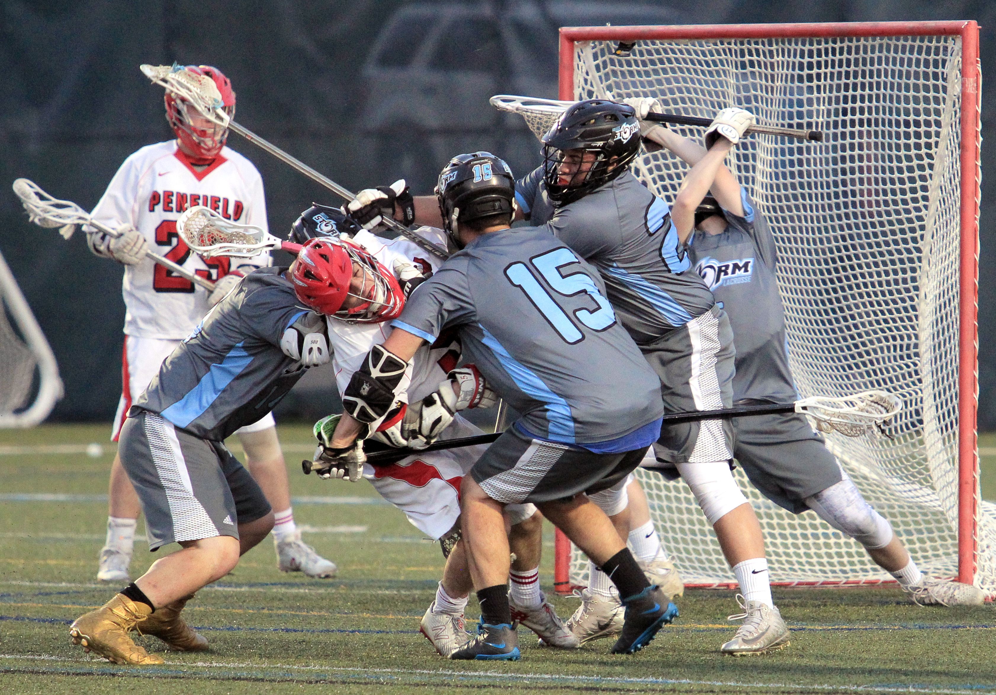

Slide 34
NCAA
ASSISTS
Manual
“Philosophy. An assist is not necessarily credited to a player who makes a pass before a goal. There should be conscious effort on the part of the passer to find an open player for a shot or to help a player work free for a shot.”

Slide 35
NCAA
ASSISTS
Manual
“There should be no particular time frame for an assist (although the pass and shot should appear to be part of the same play) nor should there be any rigid distance factor in the play (the player scoring the goal could take one step, several steps, or even run a number of yards with the ball and still have the passer credited with an assist).”

Slide 36
NCAA
ASSISTS
Manual
“An assist should not be credited on a play when the goal scorer dodges a defensive player after receiving the pass before shooting unless, in the opinion of the statistician, it was the pass itself and not the dodge that led directly to the shot.”

Slide 37
NCAA
ASSISTS
Manual
“Article 1. A player is credited with an assist when he makes, in the opinion of the statistician, a pass contributing directly to a goal. An assist cannot be credited to any player other than the one who had the ball immediately before the player credited with the goal.”

Slide 38
NCAA
ASSISTS
Manual
“Article 2. A goal that is scored when the ball deflects off of an offensive player into the goal can have an assist if, in the scorer’s opinion, the player whose action caused the ball to deflect off of the second player was attempting to pass and not shoot.”

Slide 39
Question
After three steps (or two seconds) there cannot be an assist on the play.
True or False?

Slide 40
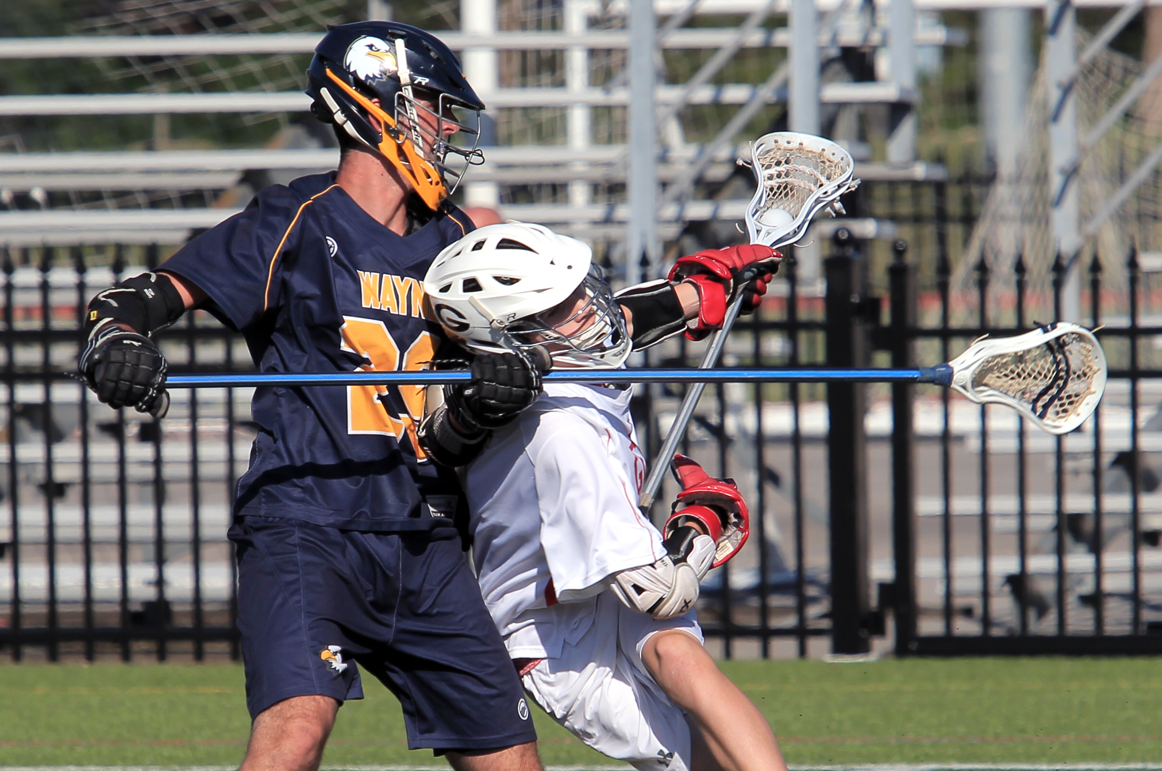

Slide 41
NCAA
SAVES
Manual
“Philosophy. The basic rule of a save is that any time a ball is stopped or deflected with any part of the goalie’s body or stick, which if not stopped or deflected would have resulted in the ball entering the goal, a save is recorded.”

Slide 42
NCAA
SAVES
Manual
“The statistician should focus on what would have happened to the ball if it had not been stopped or deflected by the goalie. If the shot would have scored, then award the goalie a save. If it would not have scored, do not credit a save. The tendency is to give a goalie a save every time he touches a shot; this creates inflated statistics.”

Slide 43
NCAA
SAVES
Manual
“No matter how difficult it is to determine, the statistician should make consistent judgments on each shot that goalies stop or deflect.
Consistency must be maintained so that the national statistics are meaningful.”

Slide 44
NCAA
SAVES
Manual
“Article 1. Offensive efforts that the goalie prevents from going into the goal are considered saves. A team save can be credited in certain situations see approved rulings below). If the goalie is in the crease, no one else can be credited with a save (including a team save).”

Slide 45
NCAA
SAVES
Manual
“Article 2. A blocked shot by a defenseman is not considered a save unless the defenseman is in the crease and the goalie is not.”
In NYS defensemen cannot enter the crease to
act as a goalie.

Slide 46
NCAA
SAVES
Manual
“Article 3. A shot that hits the pipe, rebounds off the goalie’s body and would go into the goal if not stopped by the goalie is credited as a save. A shot that hits the pipe, rebounds off the goalie’s body and would not go into the goal before being picked up by another player is credited as a ground ball.”

Slide 47
Question
The goalie catches a shot outside
the goal posts.
Is this a save?

Slide 48
Question
A shot is taken and the goalie stops
the ball from rolling into the goal.
Is this a save?

Slide 49
Question
The goalie stops a shot and takes control of the ball. He then drops the ball into the goal.
Who get credit for the goal?

Slide 50
Question
The goalie stops a shot but before he gains full control, it dribbles into the goal.
Who get credit for the goal?

Slide 51
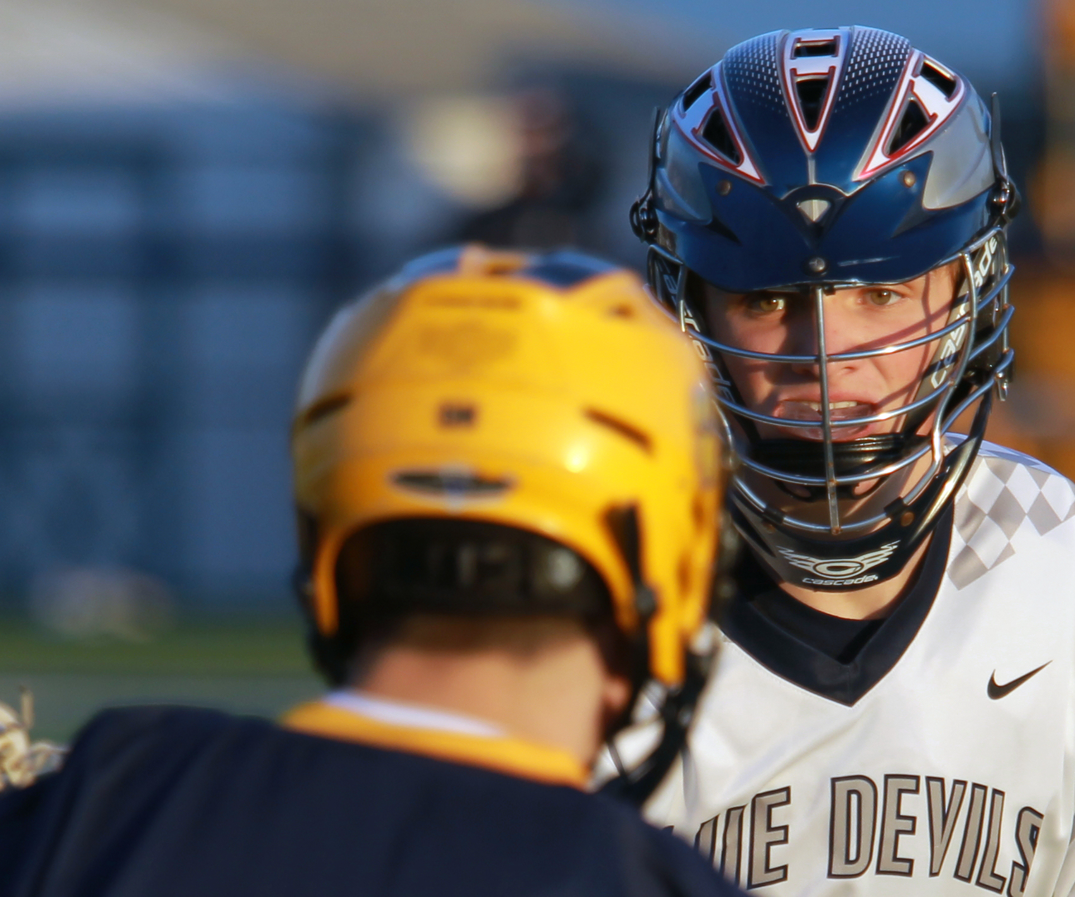

Slide 52
NCAA
GROUND BALLS
Manual
“Philosophy. Any ball not in possession of either team that comes into possession of either team should result in a ground ball once a player establishes possession and is immediately able to perform the normal functions of possession (i.e., shoot, pass, cradle), provided the ball was contested by both teams before establishing possession.”

Slide 53
NCAA
GROUND BALLS
Manual
“Article 1. The statistician will determine whether or not the ball is being contested, keeping in mind that contested could refer to the original player with possession, the player gaining possession or the ball itself.”

Slide 54
NCAA
GROUND BALLS
Manual
“Article 2. If a player is in possession of the ball, drops it while uncontested, and then regains possession, he cannot be credited with a ground ball even if he is contested while regaining possession. If that player has the ball checked out of his stick and then regains possession, he may be credited with a ground ball.”

Slide 55
NCAA
GROUND BALLS
Manual
“Article 3. Ground balls can be credited as part of the faceoff play. In a faceoff situation, a ground ball should be credited to the player who gains clear possession regardless of whether or not the player gaining possession is being contested at that time.”

Slide 56
NCAA
GROUND BALLS
Manual
“Article 4. A ground ball should be credited to an offensive or defensive player who gains possession of the ball and prevents it from either going out of bounds or reaching the midline even if the play was not being contested. The philosophy is to give statistical credit for gaining or maintaining possession.”

Slide 57
NCAA
GROUND BALLS
Manual
“Article 5. A loose ball that is not contested and would not reach the midline or go out of bounds should not result in a ground ball.”

Slide 58
Question
A ball is passed but falls on the ground and a player on the same team picks up the ball without a challenge.
Is this a ground ball?

Slide 59
Question
A ball is about the roll out of bounds but a player stops it and picks it up. There is no challenge for the ball.
Is this a ground ball?

Slide 60
Question
A ball is shot past the end line. The closest player to the ball when it goes out gets a ground ball stat.
Is this True or False?

Slide 61
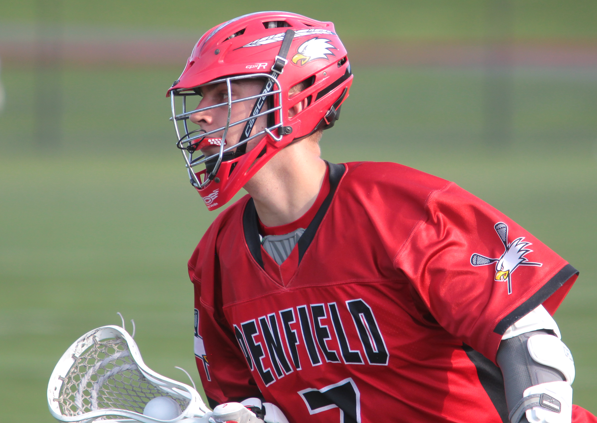

Slide 62
NCAA
TAKES
LOBs
Manual
“Article 1. Turnovers occur when a player or team in possession of the ball or entitled to possession of the ball loses possession of it, in a live-ball situation or under certain dead-ball situations.”

Slide 63
NCAA
TAKES
LOBs
Manual
“If a single player is judged to be primarily responsible for the turnover, that player is charged with the turnover. If no single player can be judged to be primarily responsible for the turnover, or if the responsibility rests with anyone not a player, then the team is charged with the turnover.”

Slide 64
NCAA
TAKES
LOBs
Manual
“Article 2. A caused turnover is credited to a player when the player’s positive, aggressive action(s) causes a turnover by the opponent. A turnover may not always warrant a caused turnover; however, caused turnovers can only be awarded to an individual player, and only one caused turnover can be awarded for a turnover.”

Slide 65
NCAA
TAKES
LOBs
Manual
“There cannot be more caused turnovers than turnovers. Any turnover charged as a team turnover cannot have a corresponding caused turnover.”

Slide 66
NCAA
TAKES
LOBs
Manual
“Article 3. For a change of possession that occurs that cannot be attributed to a particular player at the moment of the violation, the turnover should be charged as a team turnover.”

Slide 67
NCAA
TAKES
LOBs
Manual
“Article 4. A missed shot cannot be a turnover.
Article 5. All failed clears are by definition also turnovers.”

Slide 68
NCAA
TAKES
LOBs
Manual
“Article 6. A team is in possession of the ball and is called for any “failure to advance” penalty other than the failure of the goalie to leave the crease within four seconds. This should be credited as a team turnover, unless in the statistician’s opinion, one player was principally responsible…”

Slide 69
Question
When there is a “Take” there must also be a “Loss of Ball”.
Is this True or False?

Slide 70
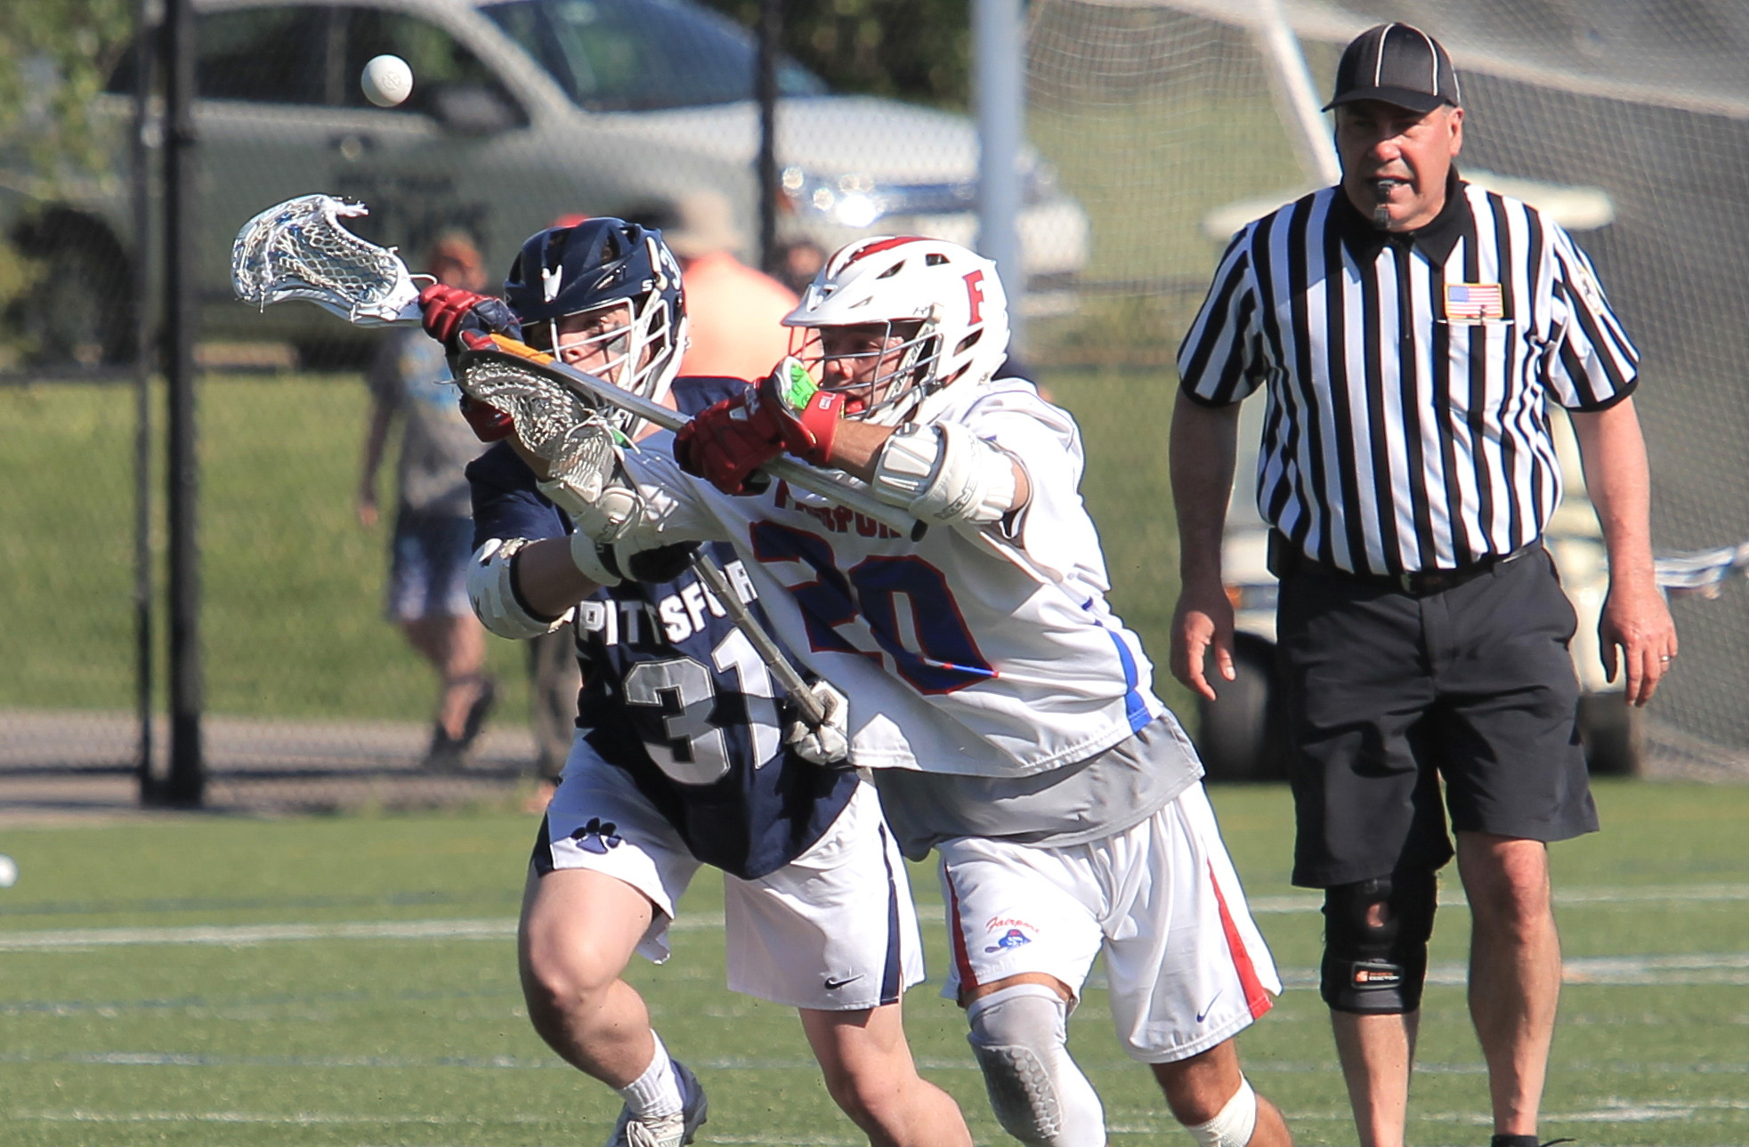

Slide 71
NCAA
Face offs
Manual
“Philosophy. Since many faceoff men must depend on the statistics of faceoffs to provide an evaluation of their value, statisticians must be consistent in their assessment of faceoffs. Since the standard in faceoff stats is to award to the faceoff man the faceoff, whether he actually obtained possession or not…”

Slide 72
NCAA
Face offs
Manual
“Additionally, ground balls should be credited in faceoff play (there can be more than one) as indicated in Section 5. Every faceoff has to end with players being credited and charged with a faceoff win and loss, unless the quarter ends before possession is established.”

Slide 73
NCAA
Face offs
Manual
“Article 1. A faceoff win is determined by clear possession of the ball, not by the subsequent offensive opportunity.”

Slide 74
NCAA
Face offs
Manual
“A standard [false] alternative to that definition is to credit and charge the faceoff when one team is declared to have possession of the ball, and wing area players are released. This is not really a viable definition since a team may never have a chance to do anything with the ball.”

Slide 75
NCAA
Face offs
Manual
“Article 2. Credit the faceoff to the team that gains clear possession of the ball and can perform the normal functions of the possession, not based on the possession that is called by the referee………”

Slide 76
NCAA
Face offs
Manual
“The referee’s signal of possession has no influence on the statistical determination of faceoff wins and losses. The referee’s signal frequently precedes the statistical definition of possession”

Slide 77
Question
A face off must have a ground ball.
Is this True or False?

Slide 78
Question
A face off must have a winner.
Is this True or False?

Slide 79
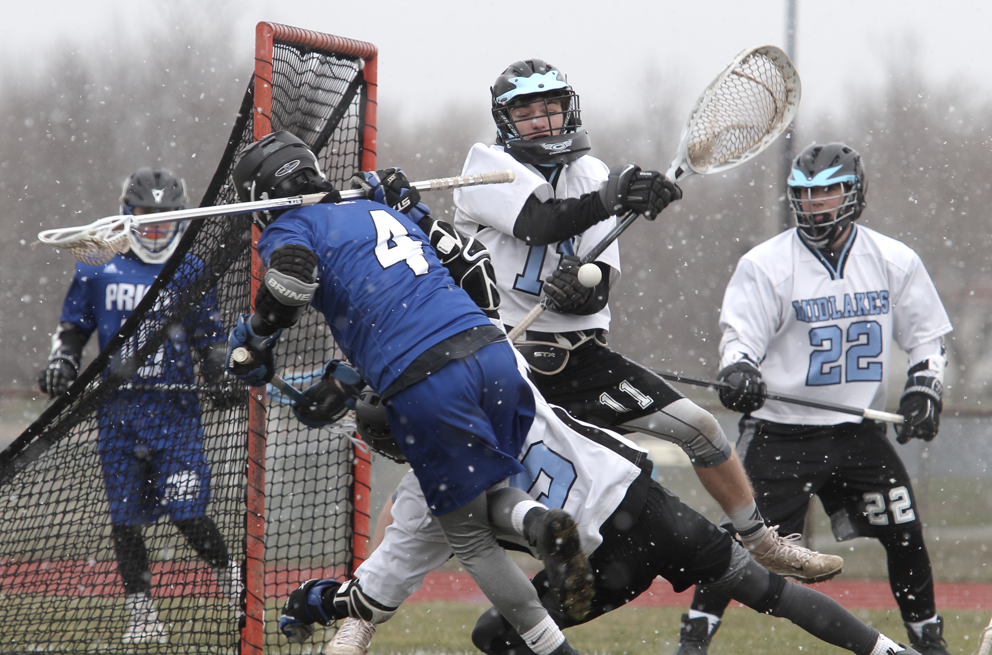

Slide 80
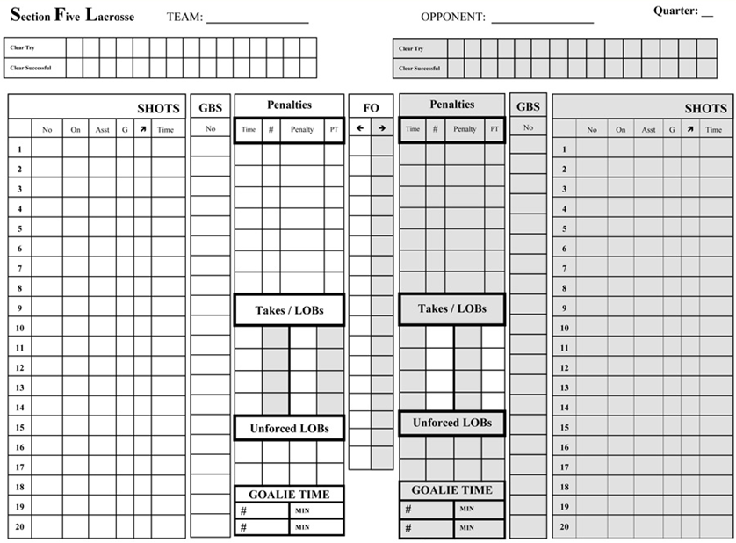
Data
Collection
“WHITE”
Team Data
“GREY”
Team Data
Game
Form
Use one sheet per quarter

Slide 81
Data
Collection
Use one sheet per quarter

Slide 82

Data
Collection
Clears
Use one sheet per quarter

Slide 83
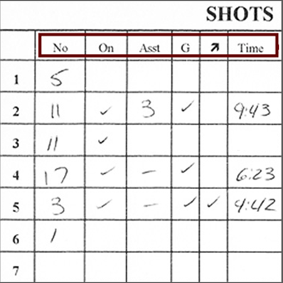
Data
Collection
SHOTS
No – Jersey #
On – Shot on goal
Asst – Assisted #
G – Goal scored
-> - Man up/Down
Time – of goal
Use one sheet per quarter

Slide 84

Data
Collection
Ground Balls
Circle ground balls won
during face offs.
Use one sheet per quarter

Slide 85
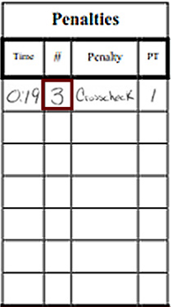
Data
Collection
Penalties
Circle the number if
EMO scores
Square means don’t
count as an
attempt.
Use one sheet per quarter

Slide 86
Question
The game is in running time and a
penalty is called.
When does the penalty time start?

Slide 87
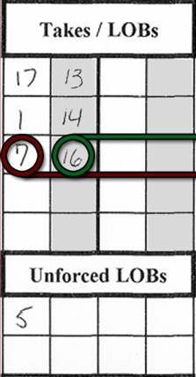
Data
Collection
Takes/LOBs
#16 lost the ball
#7 took the ball
Use one sheet per quarter

Slide 88
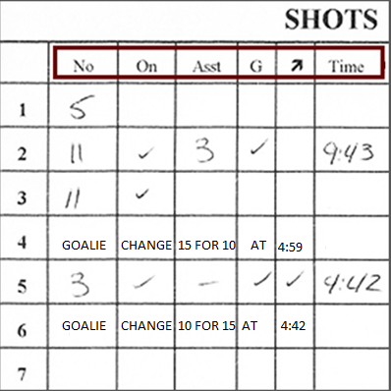
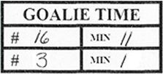
Data
Collection
Goalie Time
The number of minutes
played by each goalie.
Use one sheet per quarter

Slide 89

Data
Collection
Face Offs
Enter each FO man
and circle the winner.
If won by Tech write
“T” or put a square
around the winner
Use one sheet per quarter

Slide 90
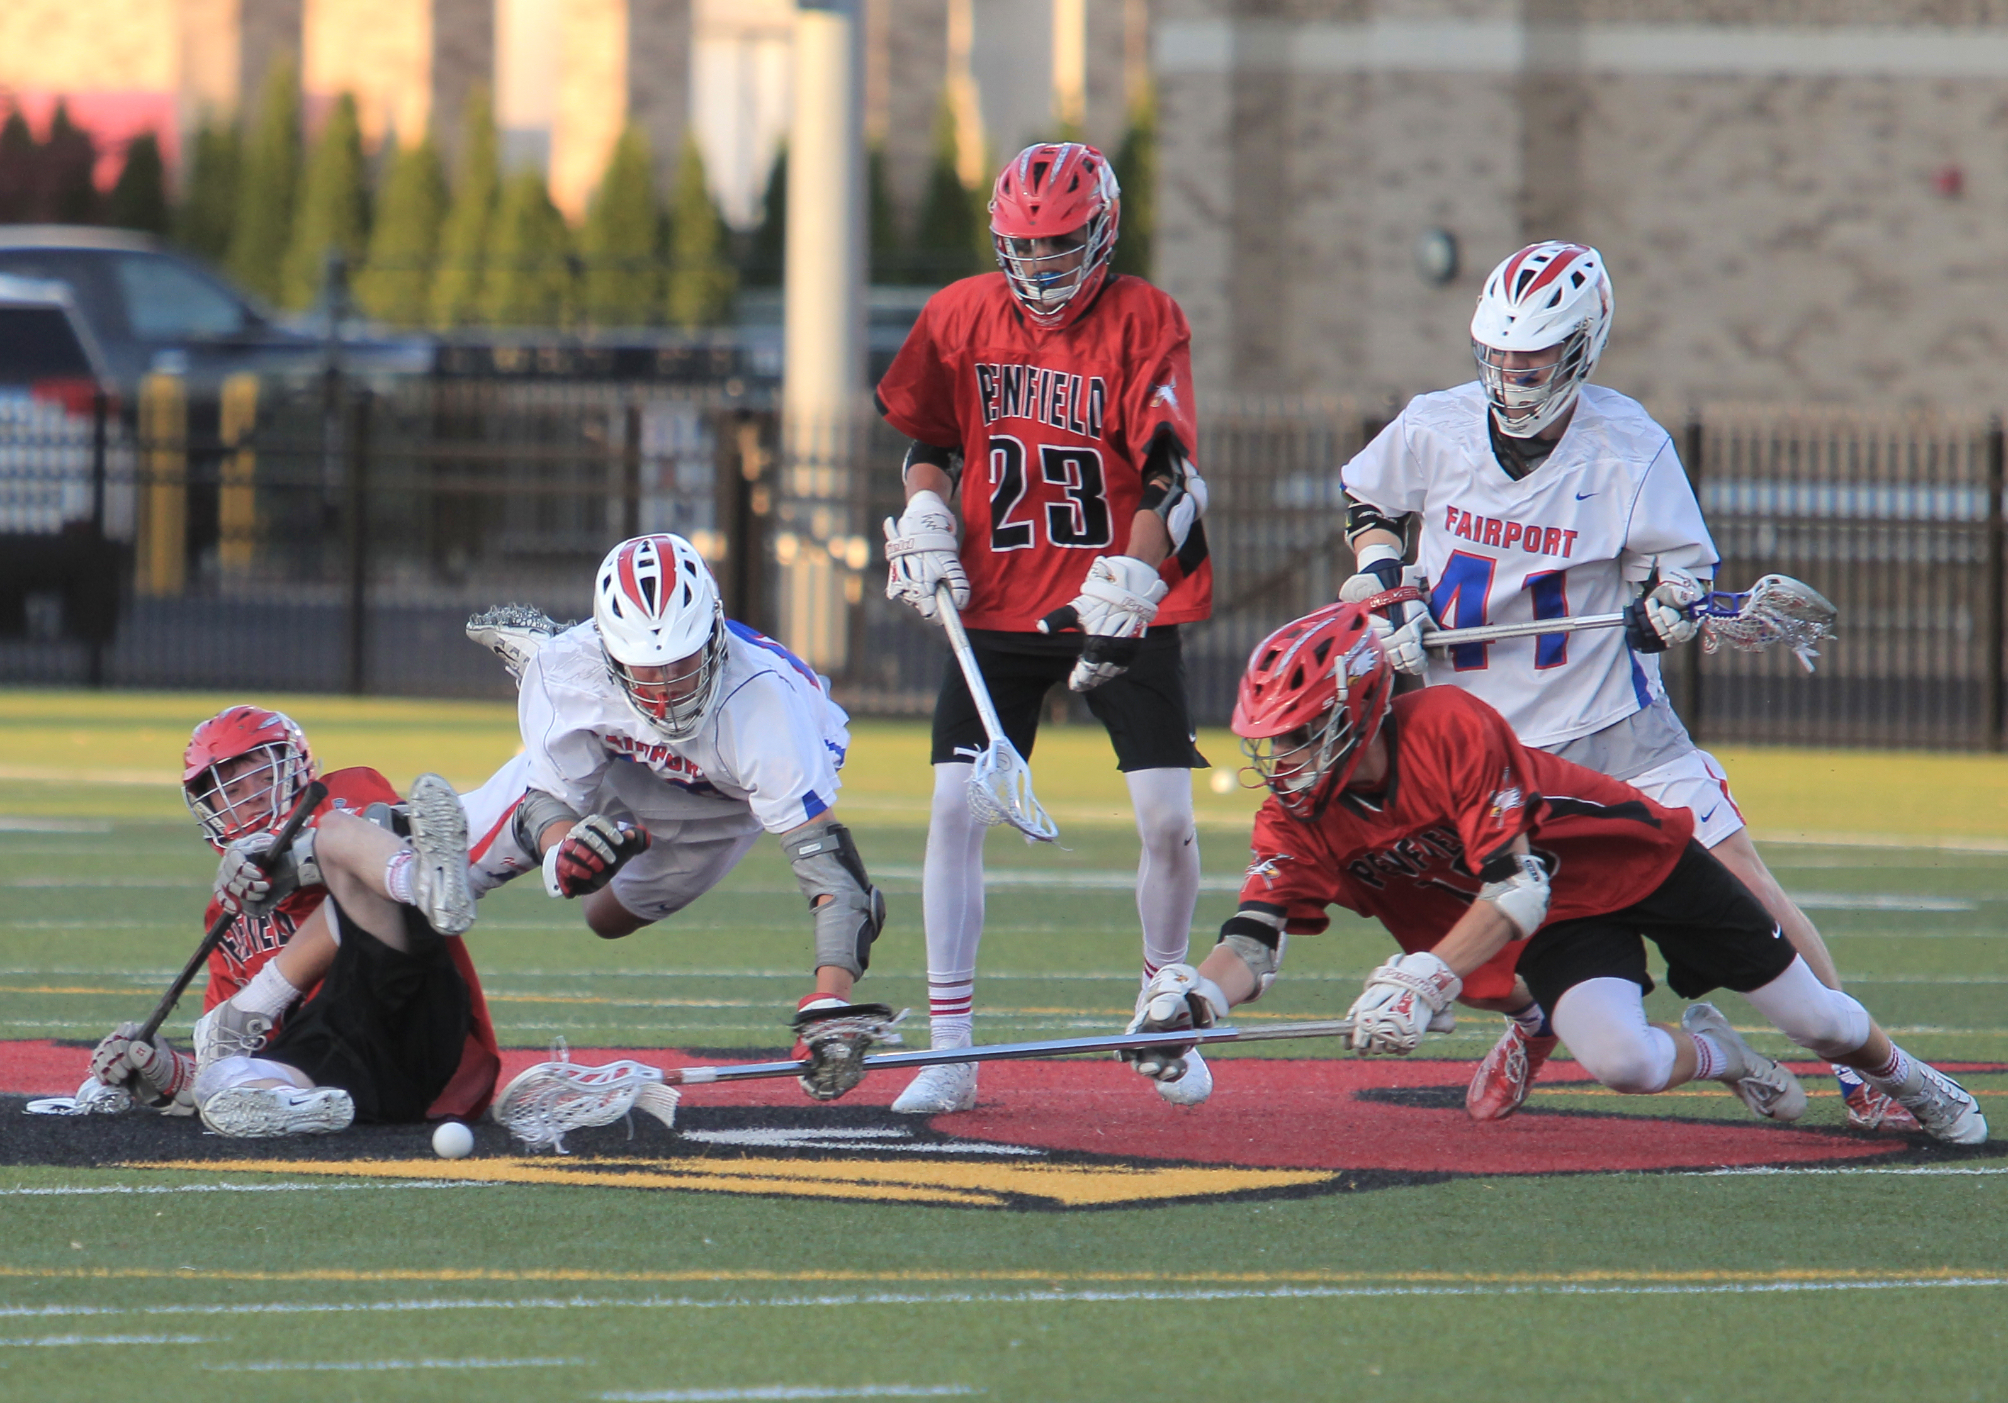

Slide 91
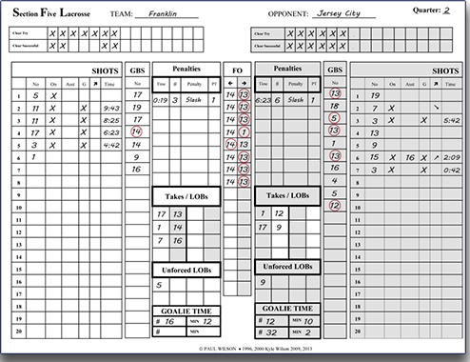
Data
Collection
Start with
information.

Slide 92
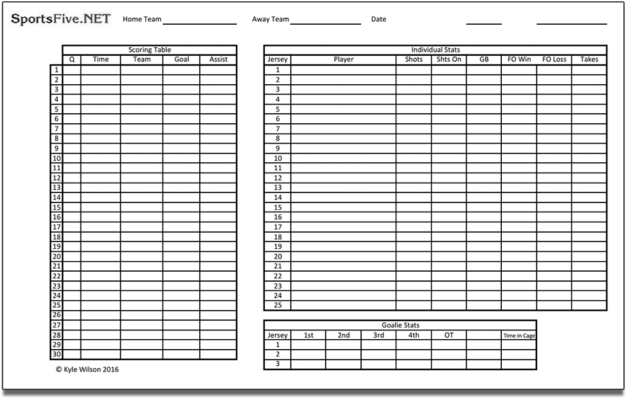
Data
Collection
Tally data.

Slide 93
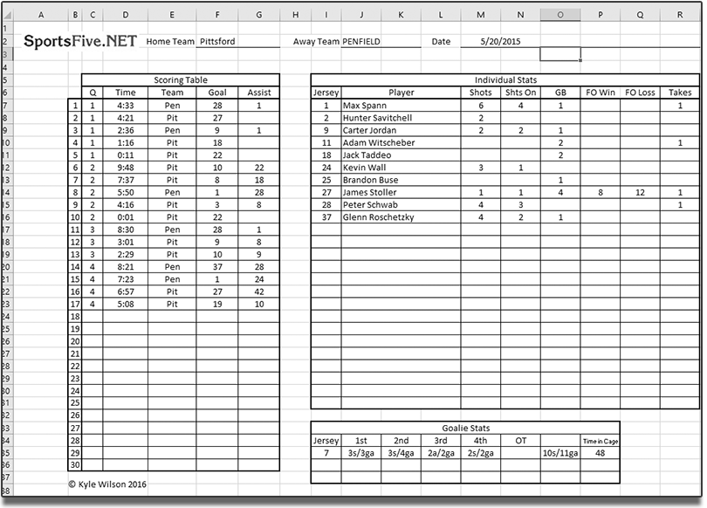
Data
Collection
Summary
Sheets

Slide 94
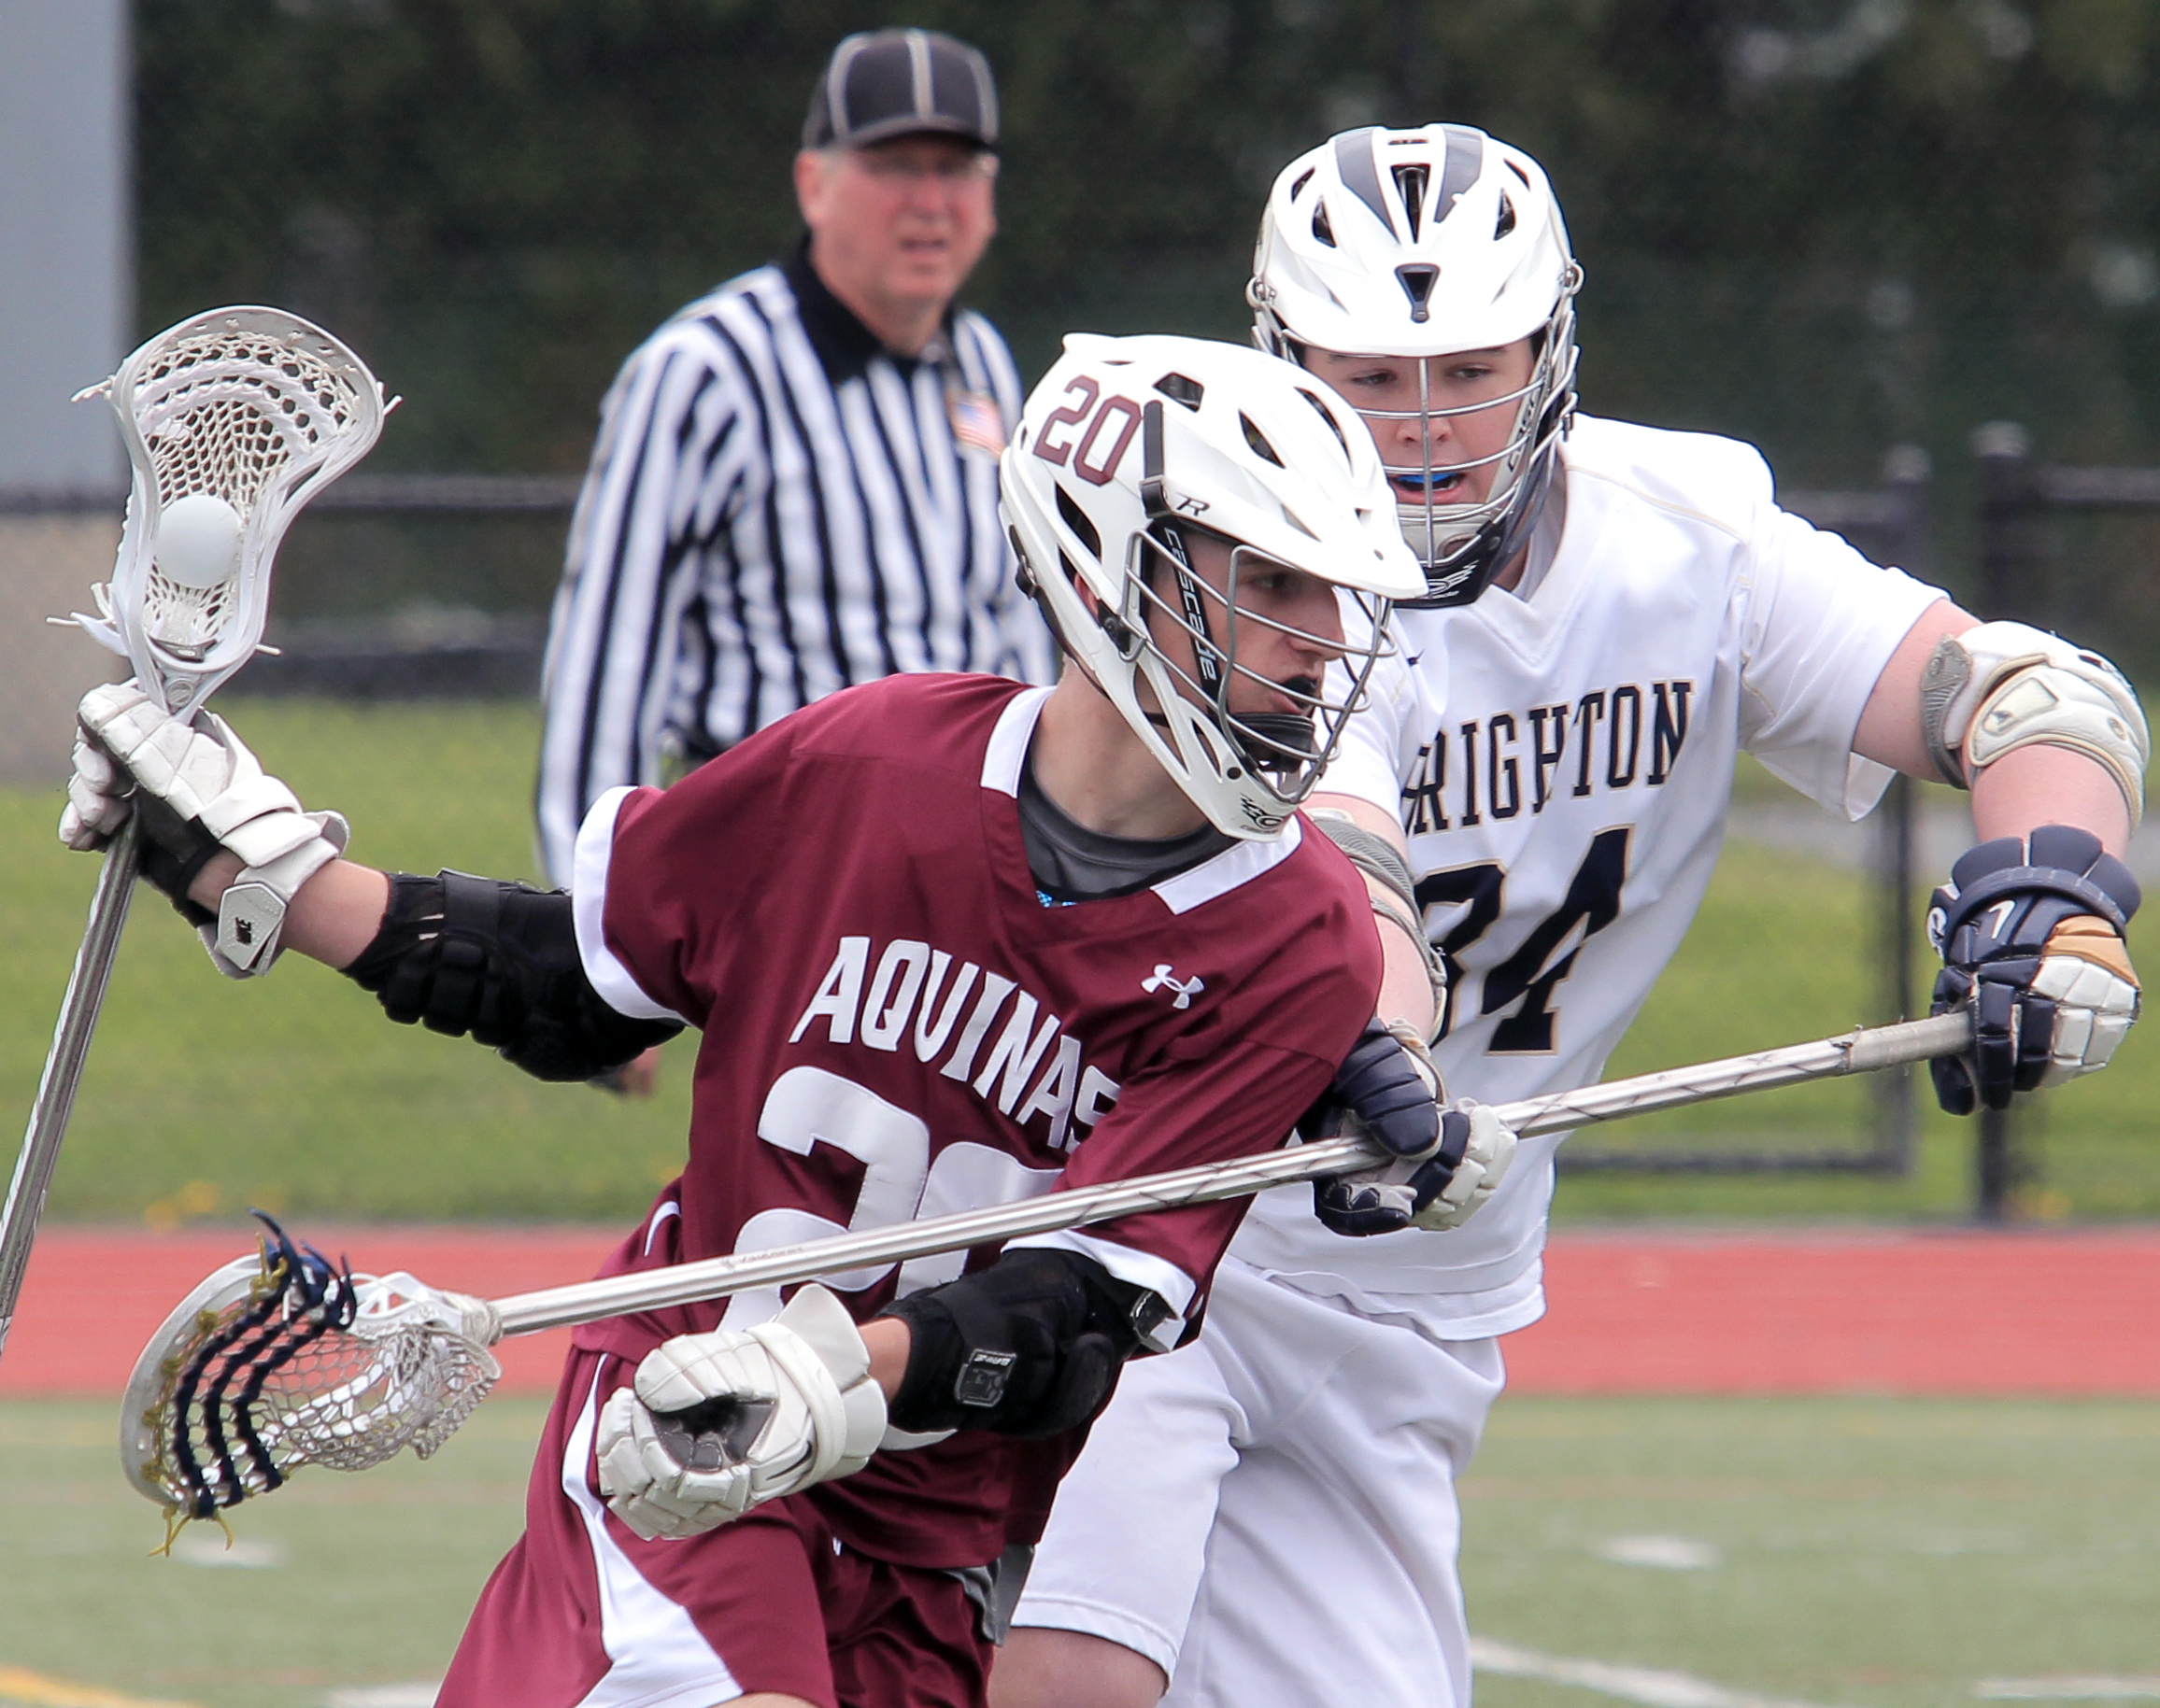

Slide 95
1st - When the
Game Ends:
Reporting
Game Information
Report the Final Score & the Quarter Scores
Send an email to: scores@sportsfive.net
Or Send a text to: 585-348-7316
Or leave message: 585-348-7316

Slide 96
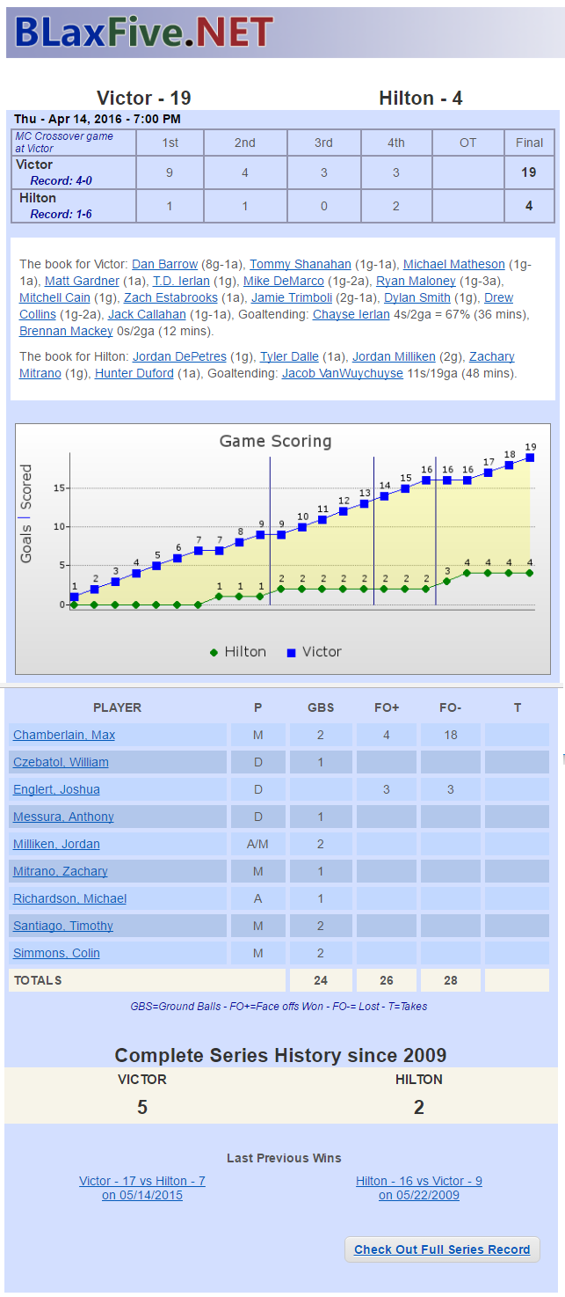
Reporting
As information arrives it shows up
Score
Quarter Scores
Scoring Table Graph
Series History
Player Data

Slide 97
2nd - Later that
SAME DAY
Reporting
Game Information
Send in Game Information
Prepare the stats – gather story information
Email them to: scores@sportsfive.net

Slide 98
3rd – The Next
DAY
Reporting
Game Information
Check the Game Story and Stats
Read the story on BLaxFive.NET
Send corrections is needed to:
Email: wilson@sportsfive.net

Slide 99
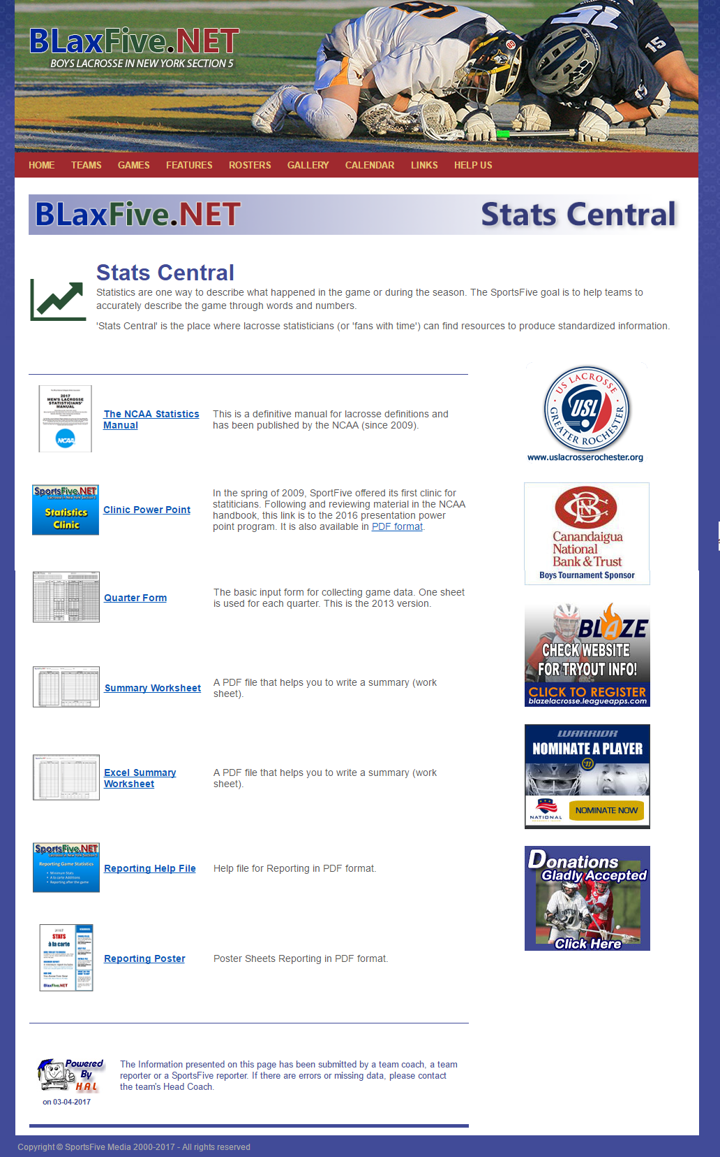
“Stats Central” Page
Stats Manual
Input Forms
Field Diagrams
And More. . .
http://blaxfive.net/features/stats_central.php

Slide 100
2019
Statistics Clinic
Boys Lacrosse in New York Section V
Thanks for all you do.

